Slide 1
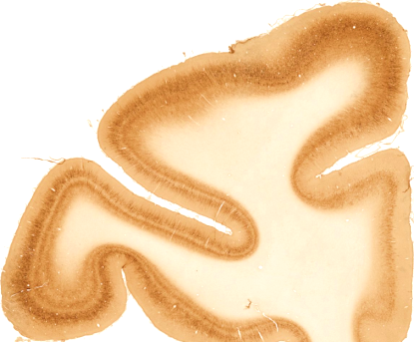
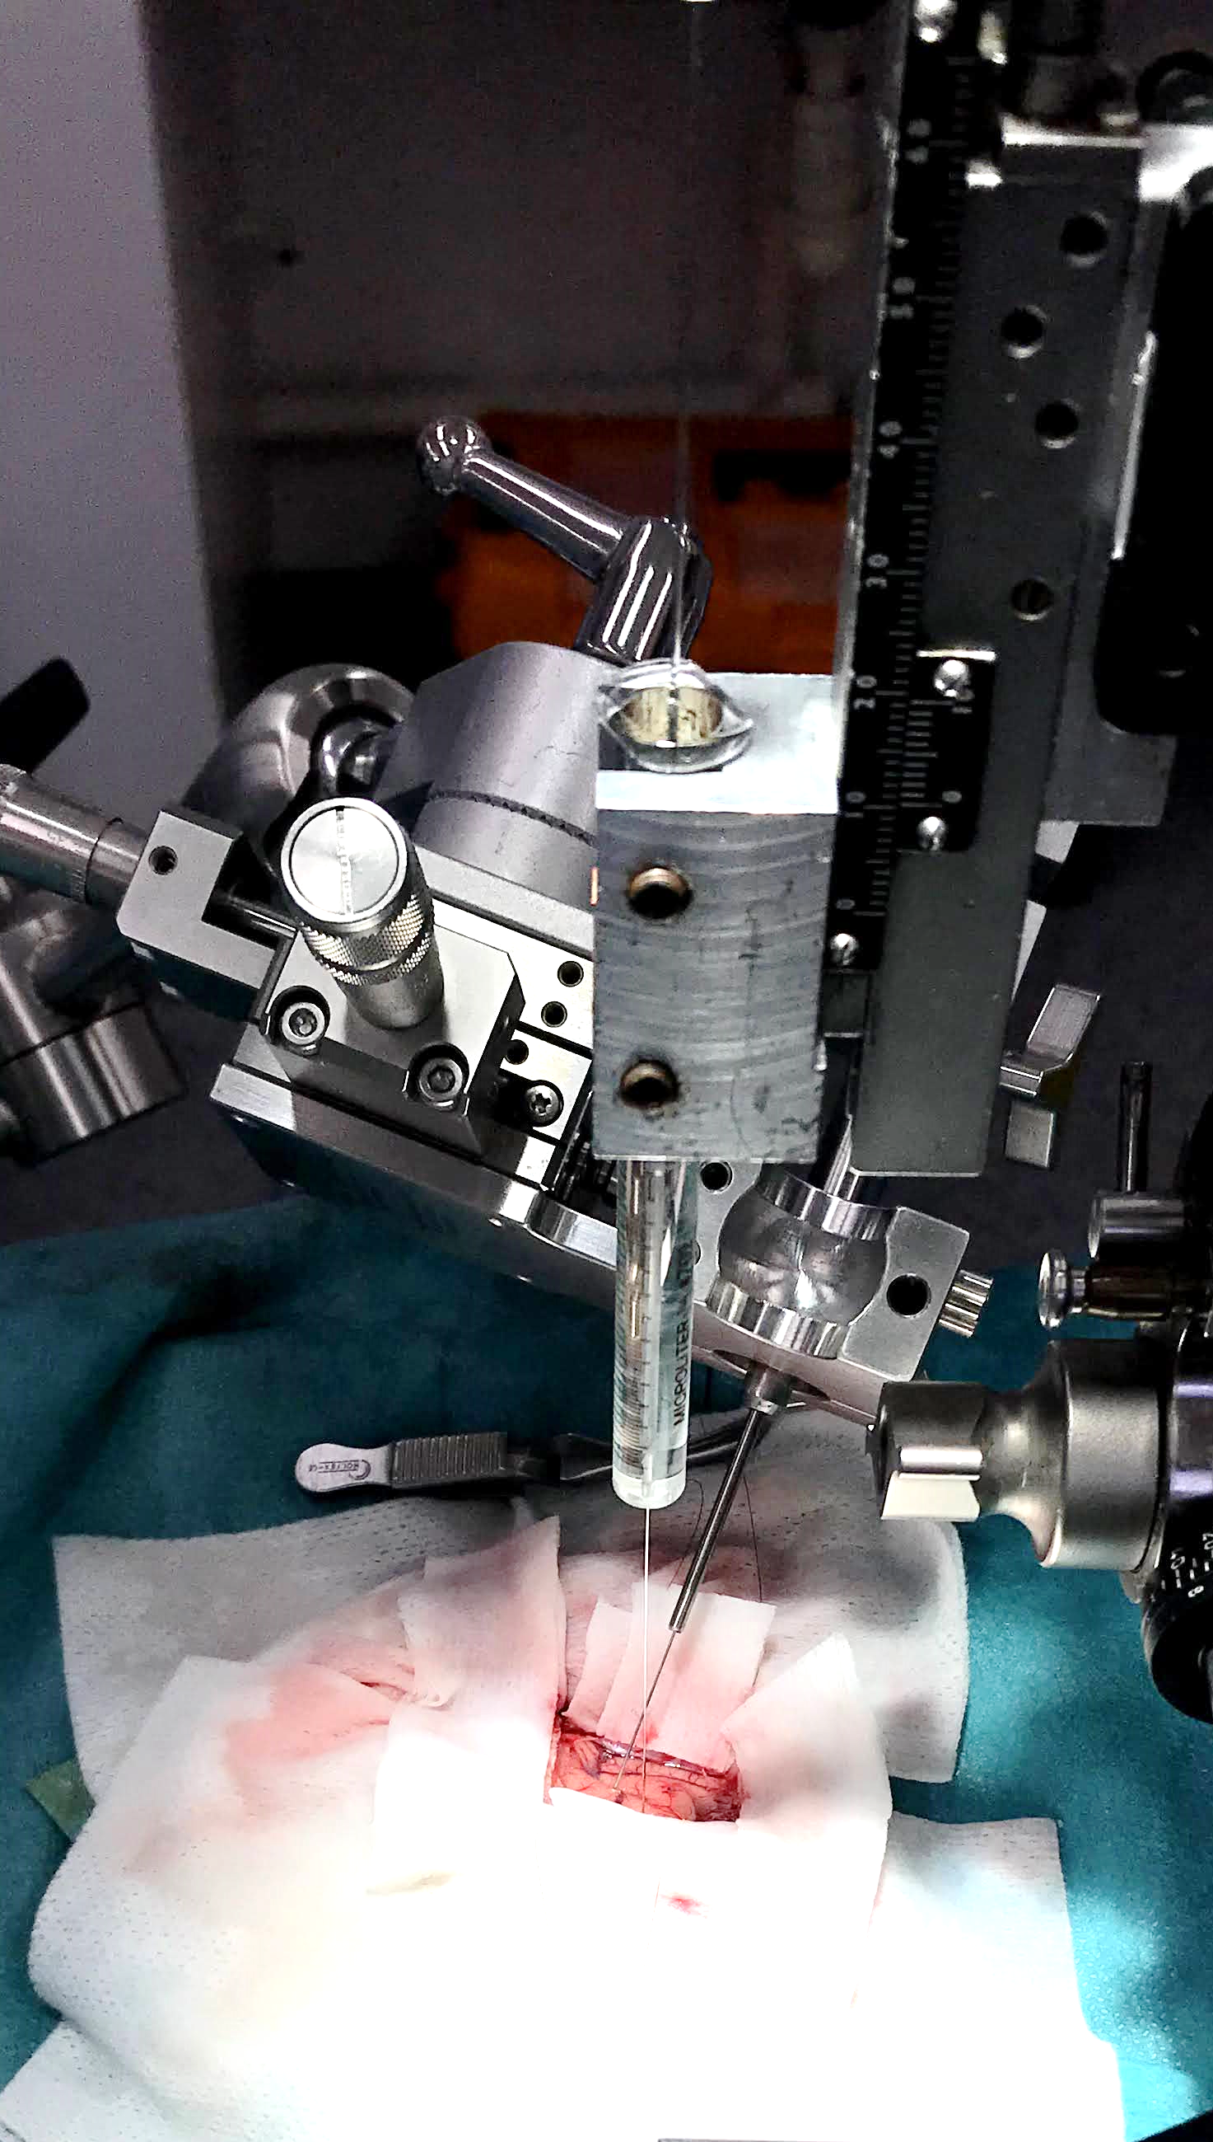
AAV hSyn-
DIO-hM3Dq-mCherry
CAV2-Cre
LPFC
MCC
CAV2-Cre
AAV hSyn-
DIO-hM3Dq-mCherry
Frontal section rhesus

Slide 2
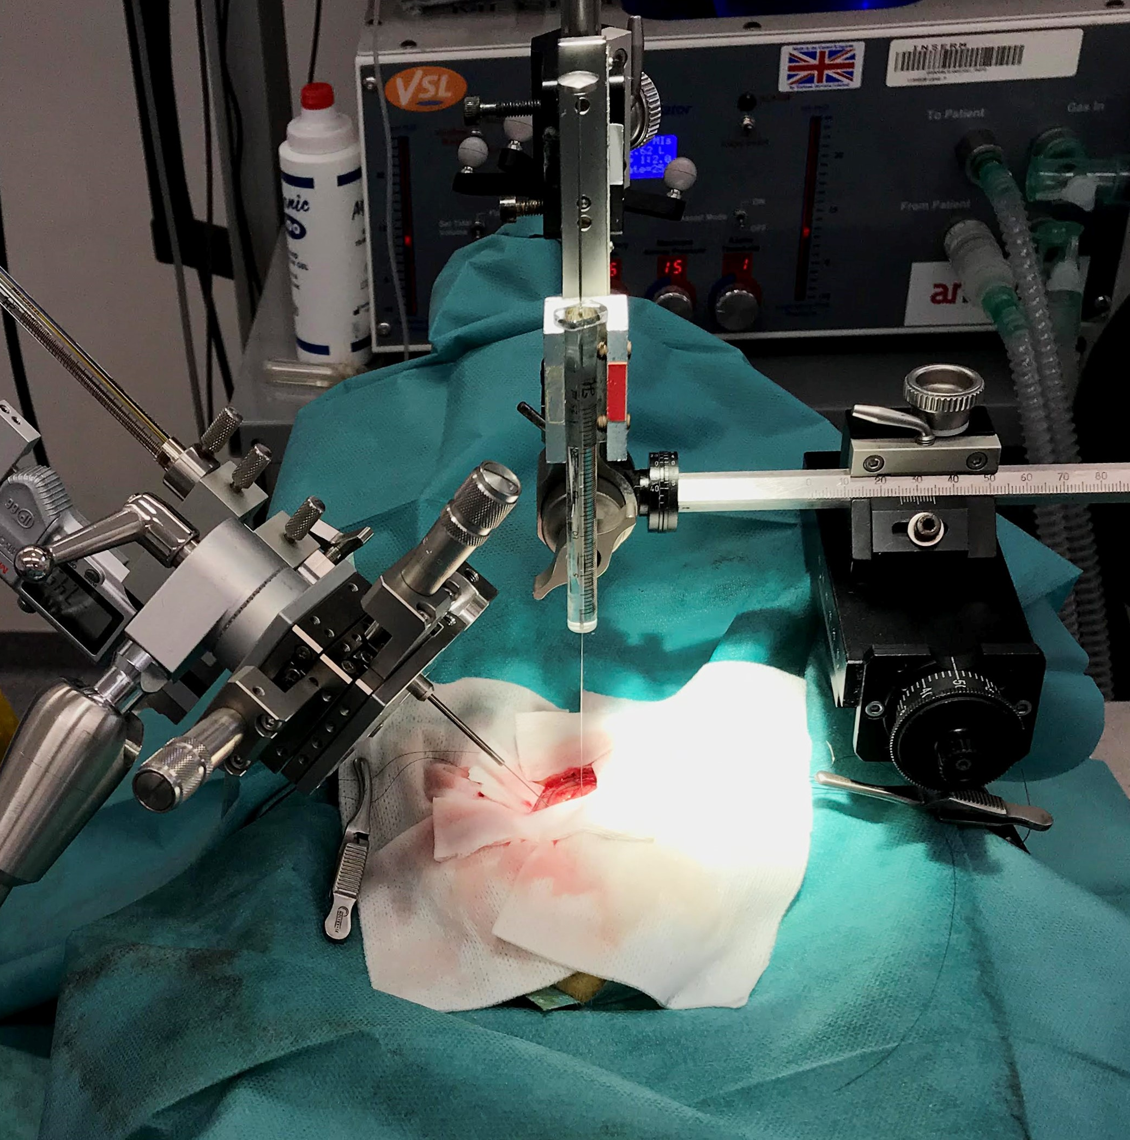
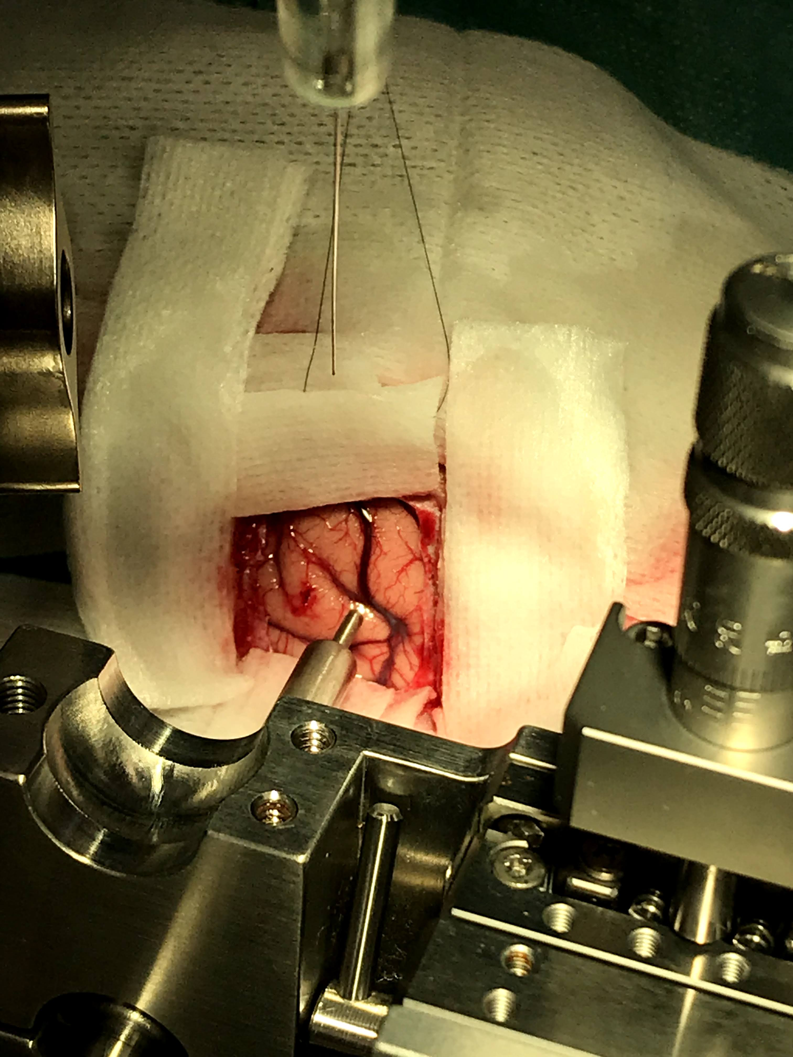
Surgeries : vectors injections for chemogenetic or optogenetic
MCC : AAV5-hSyn-DIO-hM3D(Gq)-mCherry
12 injections of 1μl
6 tracks, 2 depths per track
DLPFC: CAV2-Cre
19 injections of 1 μl
7 tracks, 3 or 2 depths per track depending on anatomy

Slide 4
Summary of results
Monkeys made more trials in the Opaque condition under DCZ
Animals took longer to gather rewards under DCZ (There is a tendency for Homer to get more rewards in Opaque but not significant, and not for Donut)
The 2 monkeys also made less MISS in DCZ than in sham at the very beginning of session.
Animals repeated more often previously selected holes (more trials)
Monkeys made repeats of a choice later under DCZ compared to SHAM (distance to repeat)
No effect of DCZ on the post-outcome distance effect
Monkeys made the same number of short pauses in DCZ and Sham sessions BUT they made short pauses earlier in SHAM sessions compared to DCZ

Slide 5
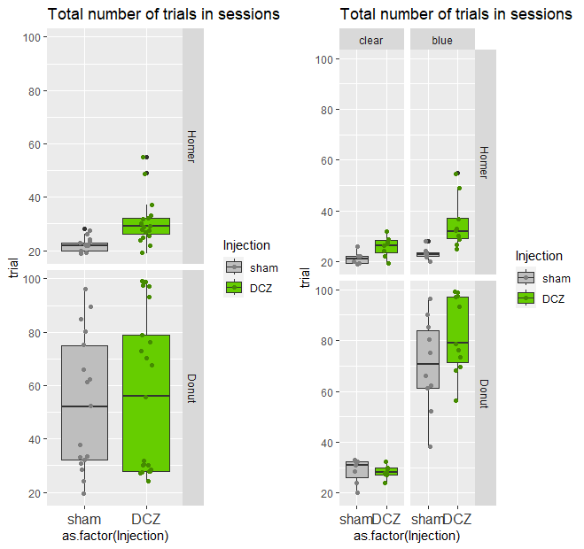
Impact on number of trials
P< 10-5
P=0.086
P< 10-4
glm(formula = trial ~ Injection, family = "poisson",
data = subset(agg.data4B, singe == "Homer" & portes == "blue"))
Coefficients: Estimate Std. Error z value Pr(>|z|)
(Intercept) 3.14169 0.07857 39.987 < 2e-16 ***
InjectionDCZ 0.41999 0.09658 4.349 1.37e-05 ***
ns
glm(formula = trial ~ Injection, family = "poisson",
data = subset(agg.data4B, singe == "Donut" & portes == "blue"))
Coefficients: Estimate Std. Error z value Pr(>|z|)
(Intercept) 4.25561 0.03766 112.99 < 2e-16 ***
InjectionDCZ 0.15663 0.05021 3.12 0.00181 **
ns
P< 0.002
Monkeys made more trials in the Opaque condition under DCZ
[not significant in Clear: very important]

Slide 6
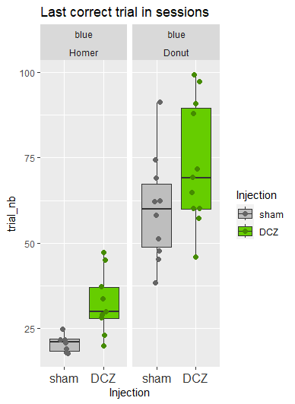
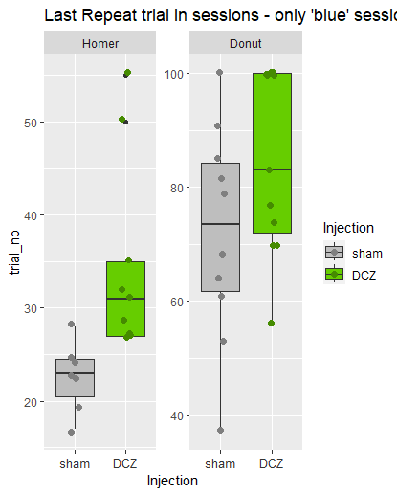
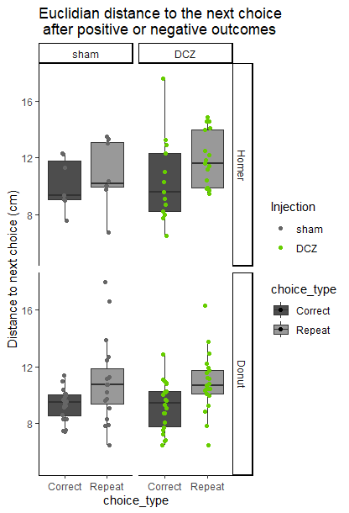
Impact on number of trials vs. on post-error
***
8.47e-06
***
9.44e-06
***
0.00112
***
0.000184
Animals took longer to gather rewards under DCZ
They might take more rewards even in clear conditions
(more persistent/compulsive?)
No effect of DCZ on post-outcome distance
(post-error is significant on a lmm with the 2 monkeys , and there is no interaction with DCZ)(single mk: not with Ho)
nextdist ~ Injection *choice_type, random=~1|singe
Animals repeated more often previously selected holes -
InjectionDCZ 0.586587 0.6955482 127 0.843345 0.4006
choice_typeRepeat 1.700747 0.7381438 127 2.304086 0.0228
InjectionDCZ:choice_typeRepeat -0.215577 0.9666098 127 -0.223024 0.8239

Slide 7
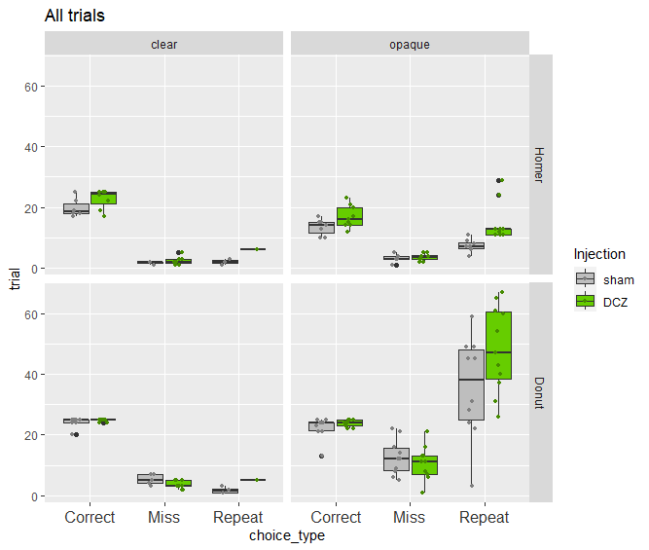
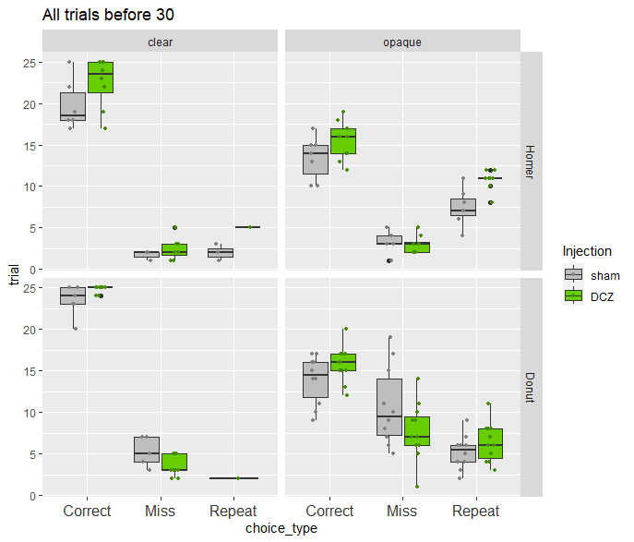
trial ~ choice_type/Injection + (1| singe)
choice_typeCorrect:InjectionDCZ 0.12516 0.08648 1.447 0.14781
choice_typeMiss:InjectionDCZ -0.34906 0.13180 -2.648 0.00809 **
choice_typeRepeat:InjectionDCZ 0.31108 0.12491 2.490 0.01276 *
([when separate model for both monkeys; only Donut has decreased MISS and Homer increased REPEATS)
Choicetype/Injection
Interaction Repeat:injection: p<10-4
Choicetype/Injection
Interaction Repeat:injection: p<10-5
The 2 monkeys made more repeat trials under DCZ
The 2 monkeys also made less MISS in DCZ than in sham at the very beginning of session.

Slide 8
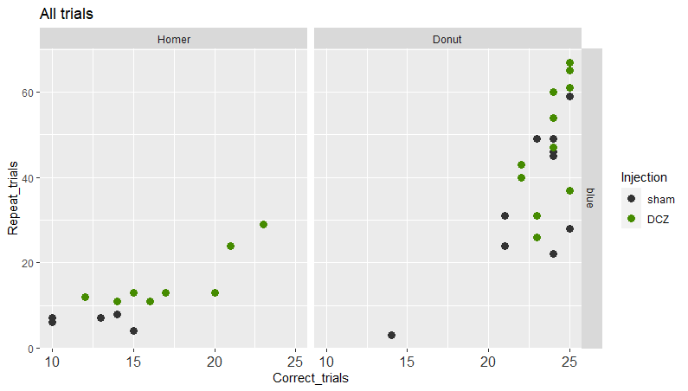
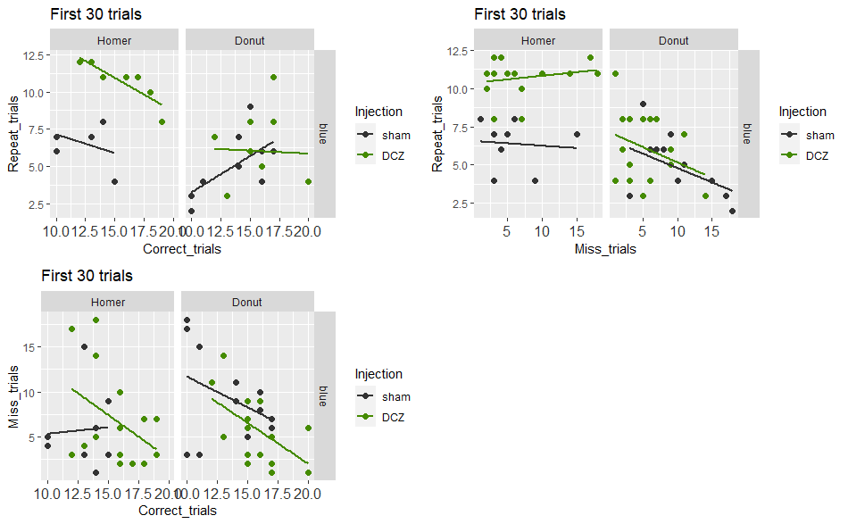
Opaque only
In theory, the longer the animal searches, the more reward it finds, but also -if its search is non-optimal- the more repeats it should do. THUS #repeats and #Correct should be positively correlated.
This is what we see for the ALL TRIAL figure on the left.
But the plot for the first 30 trials, the relationships should be negative since Correct + Repeat should compensate each other. We see that this is not the case in particular for Sham sessions/Donut. SO this reveals that the alternative trials (MISS) are more prominent in Sham than in DCZ.

Slide 9
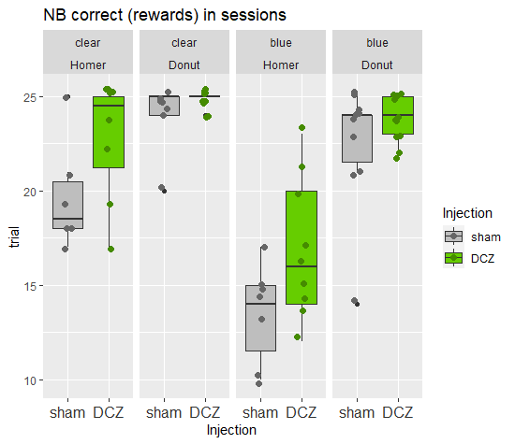
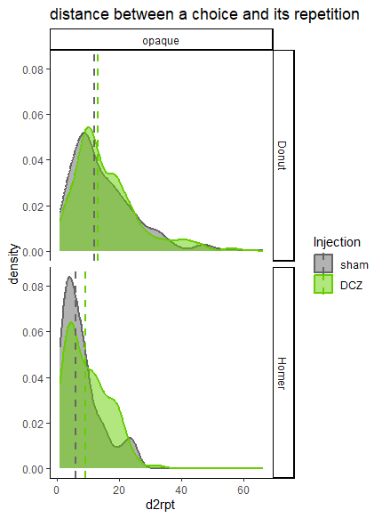
.
0.0806
***
ns
ns
ns
(Poisson glm)
d2rpt ~ Injection + (1 | singe)
InjectionDCZ 0.07538 0.01683 4.479 7.49e-06 ***
(works also for single monkey glm)
(blue sessions)
There is a tendency for Homer to get more rewards in Opaque but not significant, and not for Donut
(problem stats: numbers are saturating @ 25)
Monkeys made repeats of one choice later under DCZ compared to sham

Slide 10
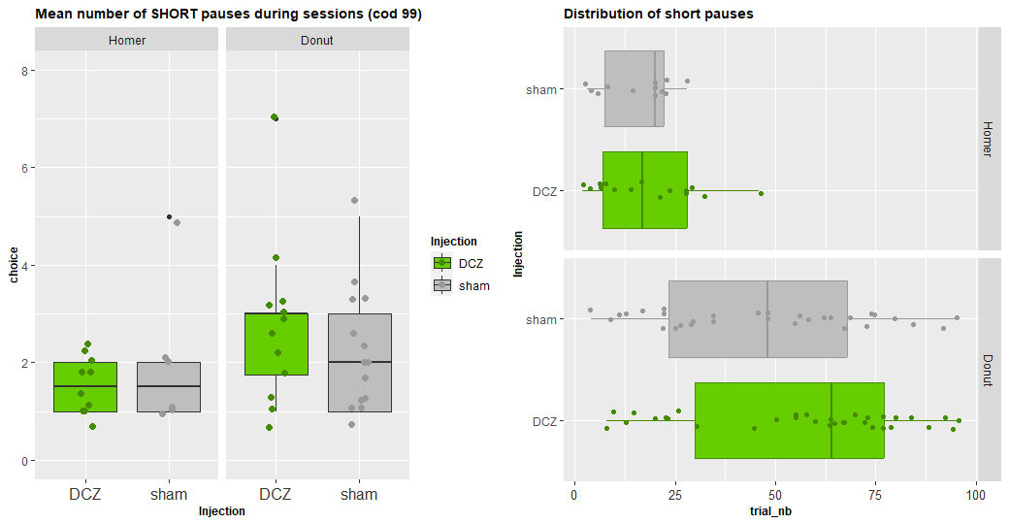
PAUSES
STATS: All session ; both monkeys (poisson glmm, Rand=singe: Injection p< 10-8)
[here all sessions together)
Homer: p < 0.133 ; Donut : p < 10-7
ns
ns
ns
***
Monkeys made the same number of short pauses in DCZ and Sham sessions
Monkeys made short pauses earlier in sham sessions compared to DCZ

Slide 11
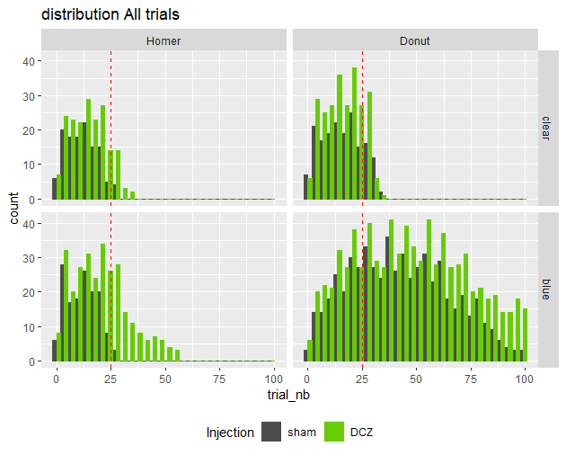
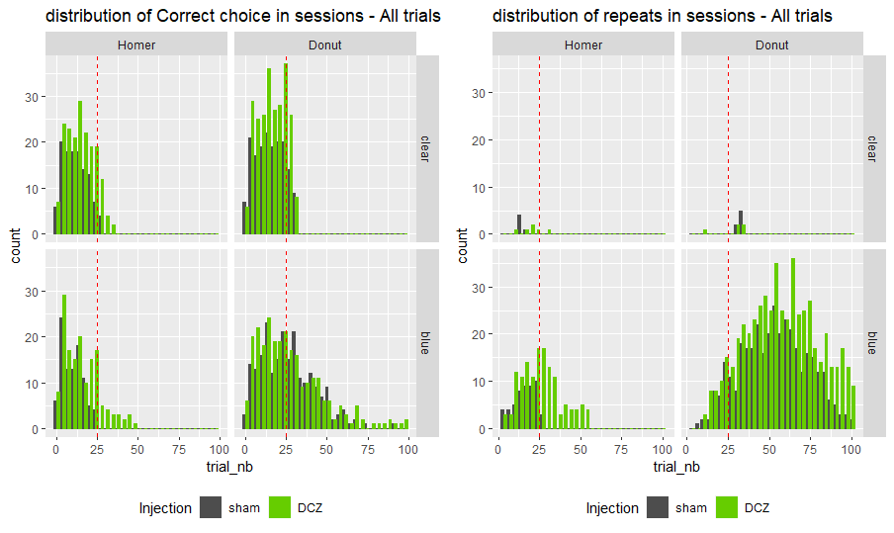

Slide 12
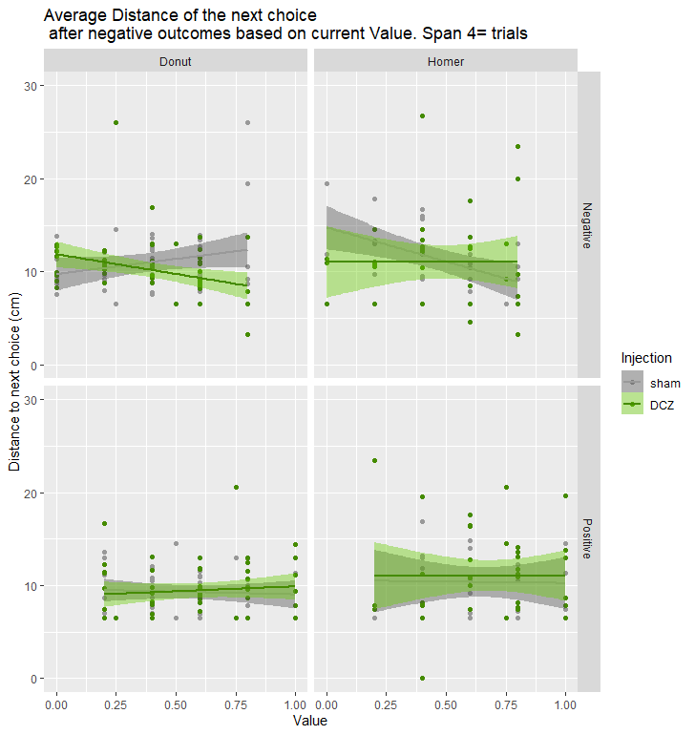
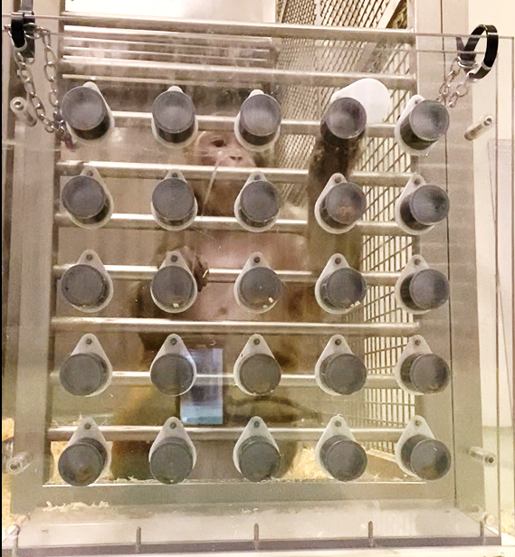
Value:InjectionDCZ -7.5246 2.3665 -3.180 0.00195 **
Value:InjectionDCZ 10.885 5.675 1.918 0.0600 .
Open no take
v
Rwd falls
Looks away
NS
NS
v

Slide 13
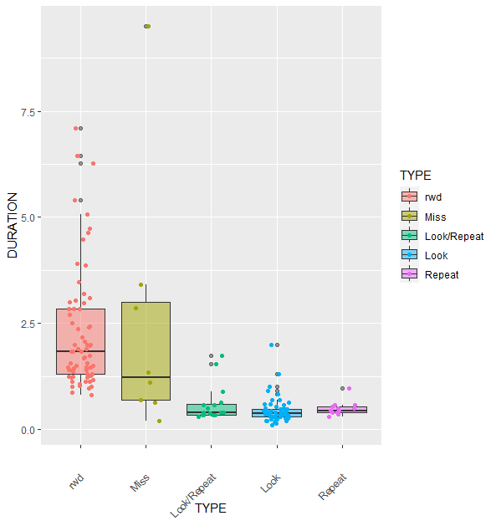
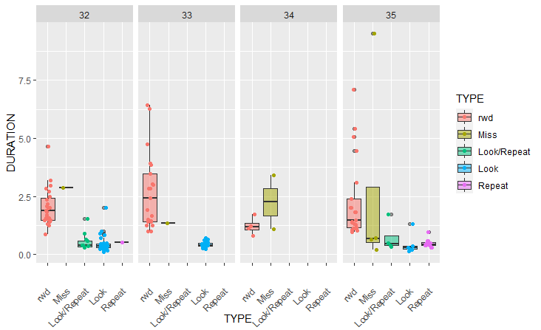
Homer

Slide 15
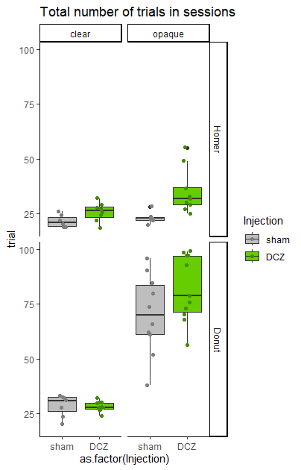
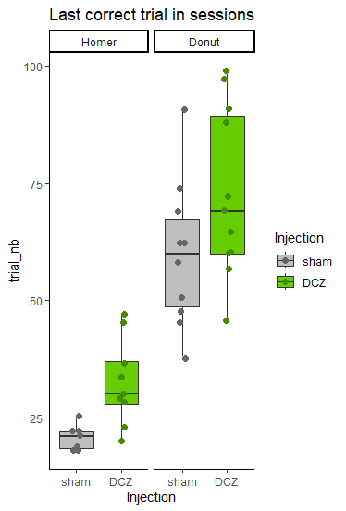
A
B
C
***
8.47e-06
***
0.000184
P=0.086
P< 10-4
ns
P< 0.002

Slide 16
A
B
ns
ns
ns (p=0.10)
***

